Slide 1
Towards more comprehensive measures of well-being: Developing integrated statistics to understand linkages between economy, environment and society
Presentation to CSLS
Statistics Canada
June 27, 2024

Slide 2
Topics
Major advances to develop an integrated framework for measuring inclusive and sustainable well-being based on Canada's Quality of Life Framework
Enhancements to the SNA framework: Strengthening the capacity of economic statistics to measure the inclusiveness and sustainability of economic activity.
Situating these efforts within international momentum to go beyond GDP
Leading international efforts to develop more integrated social, economic and environmental statistics.

Slide 3
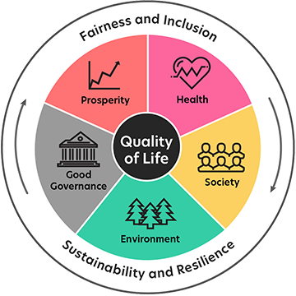
Statistics Canada’s Quality of Life Framework
84 key indicators on the well-being of people in Canada, classified into five domains: prosperity, health, society, environment, and good governance.
Includes two overall measures of well-being: life satisfaction and sense of meaning and purpose.
Allows for integrated perspectives that better connect the economic, social and environmental realities facing diverse population groups.
Goal is timelier reporting on how Canadians are doing; substantial recent progress on developing regular time series data for social data

Slide 5
Quality of life dashboard: Monitoring changes in well-being on a regular basis via the Canadian Social Survey
Quality of life indicators
Life satisfaction
Sense of meaning and purpose
Future outlook
Loneliness
Someone to count on
Sense of belonging to local community
Difficulty meeting financial needs
Perceived mental health
Confidence in institutions
Socio-demographic
characteristics
Age
Gender
Immigration status
Visible minority group
Educational attainment
LGBTQ2+
Urban / rural
Fairness and inclusion lens
Quarterly time series
Q2 2021
Q1 2024

Slide 6
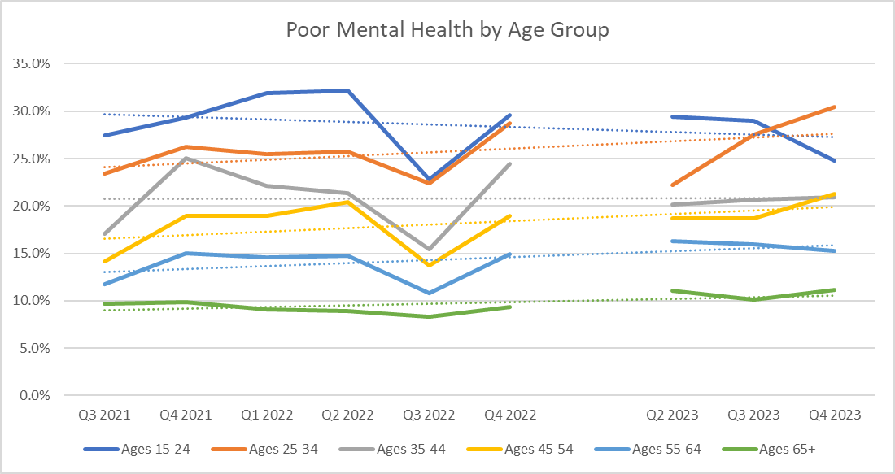
Quality of life indicators, mental health: More young Canadians reporting poor mental health
A decade ago, young Canadians reported better mental health than their older counterparts.
However, the situation has since been reversed. Recently, a lower proportion of young Canadians reported having excellent or very good mental health compared with older Canadians.
Source(s): Statistics Canada, Canadian Social Survey, Waves 1-11.

Slide 7
Quality of Life Framework: Pressures build on young Canadians
In 2016, nearly 8 in 10 Canadians aged 15 to 34 were always or often hopeful about the future. In 2021/2022, only 63% of Canadians in this age range had a positive outlook, a decline of 15 percentage points.
During the fourth quarter of 2023, 37% of people aged 25 to 34 reported high levels of life satisfaction. This is similar to estimates for the fourth quarter of 2022 and down about 8 percentage points from levels in late 2021.
Cost pressures weighing on family formation: In 2022, 38% of young adults (aged 20 to 29) did not believe they could afford to have a child in the next three years, while 32% did not believe they would have access to suitable housing to start a family during this time frame.
The recent World Happiness Report found that while seniors in Canada ranked 8th internationally on life satisfaction, youth ranked 58th—the 3rd greatest gap internationally.

Slide 8
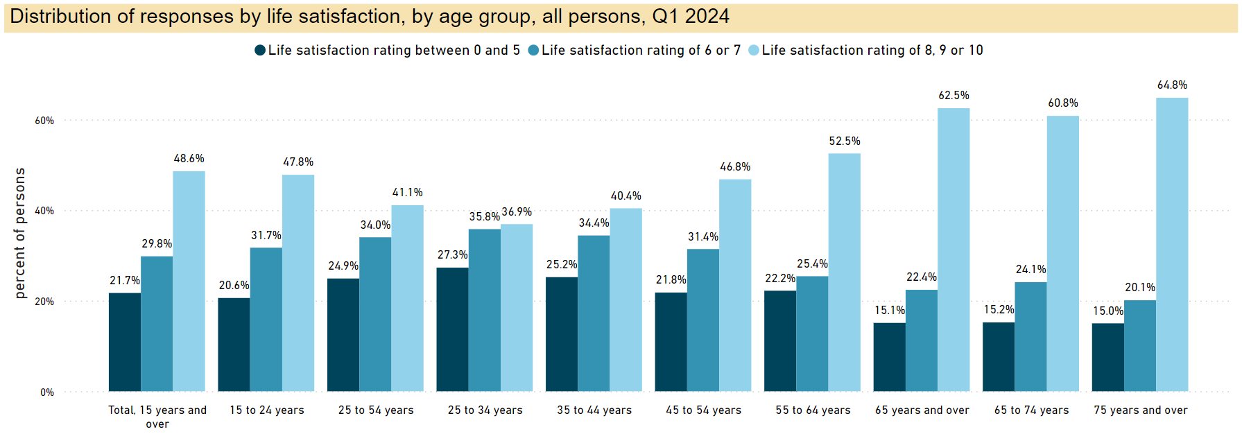
Economic pressures weigh on life satisfaction for young households

Slide 9
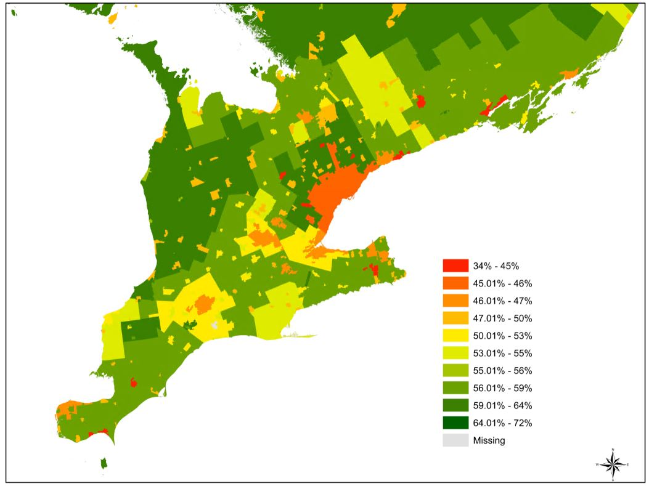
Quality of Life Framework: Well-being and the urban-rural divide
Life satisfaction
National average: 51%
Source(s): Statistics Canada, Canadian Social Survey, Waves 1-9.

Slide 10
SNA 2025: Encompassing measures of economic well-being and sustainability
A major priority for SNA 2025 is the need to strengthen the capacity of economic statistics to inform changes in household well-being and sustainability. This entails:
More granular statistics on the distributions of household income, consumption, saving and wealth (designed to measure the inclusiveness of economic activity)
Estimates of unpaid household service work (activities taking place outside the boundaries of the market economy such as unpaid household activities)
New measures for labour, education, and human capital
Environmental-economic accounting (measuring how human beings’ impact on the environment may affect their future economic well-being)

Slide 11
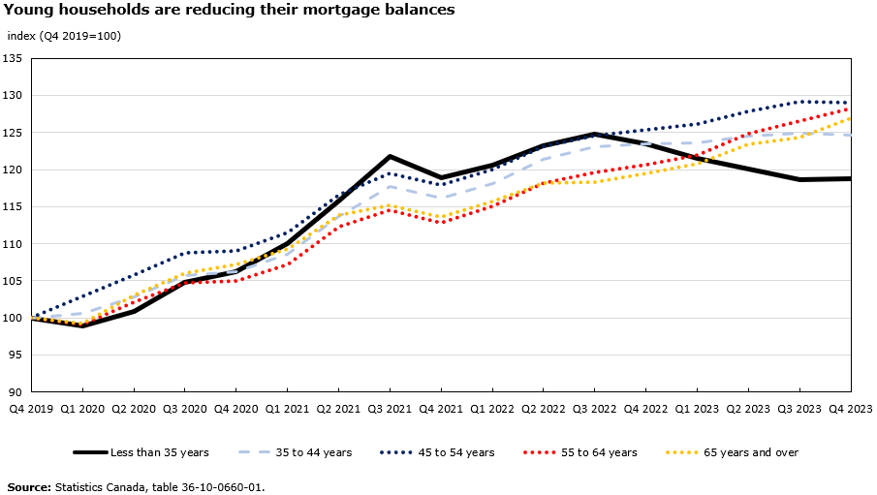
Distributions of Household Economic Accounts: Declining mortgage balances for young households
The reduction in mortgage balances suggests that young families may be turning away from the housing market, paying off existing debt faster, or downgrading to more affordable accommodations.
Lower balances in recent quarters also contrast with the sharp buildup of mortgage debt among young households early in the pandemic when many took advantage of more favourable borrowing conditions.

Slide 12
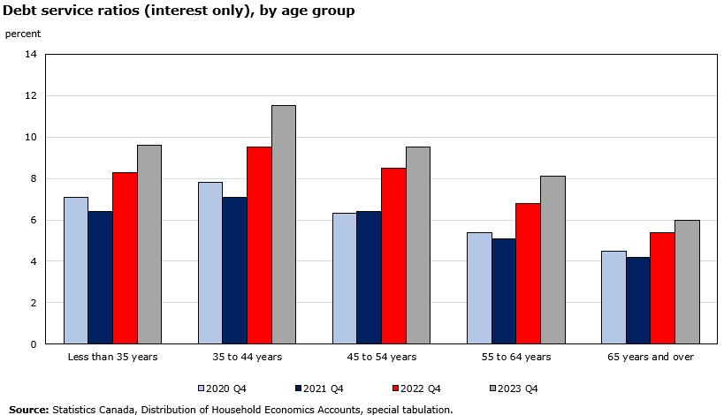
Distributions of household economic accounts: Young households face large increases in debt servicing costs
While the mortgage balances and debt-to-income ratios of young households have fallen, debt servicing costs have increased markedly.
Younger households have experienced some of the largest increases in their debt service ratios over the past year, as they tend to have higher mortgage balances to pay off than older households.
In late 2023, households whose primary earner is less than 35 years old spent about 10 cents of every dollar earned servicing their debt, up from around 8 cents in late 2022.

Slide 13
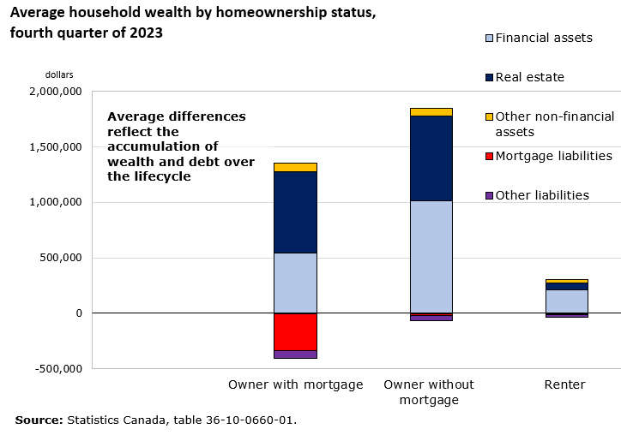
Distributions of household economic accounts, income and wealth: Sharp divide between homeowners and renters
Rising living costs have weighed on many households: Net saving has deteriorated as renters, lower-income, and middle-income households are spending more than they earn.
In 2023, renters spent 30.6% of their income on housing while homeowners spent 20.9%
Homeowners accounted for 91.0% of all wealth at the end of 2023, due equally to real estate and financial asset holdings.

Slide 14
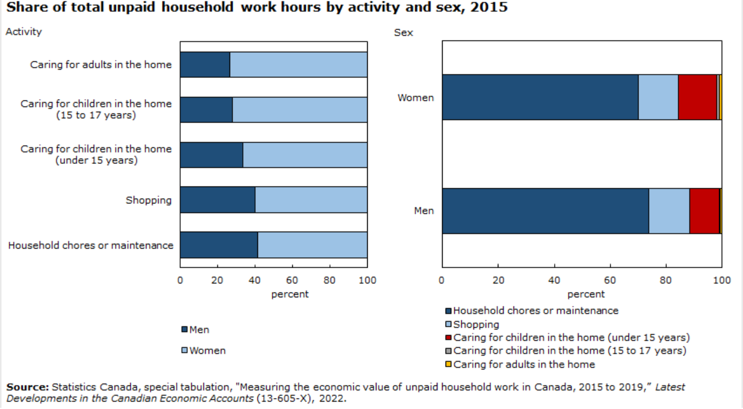
Moving beyond the production boundary: Value of unpaid household services
The economic value of unpaid household work in Canada was between $516.9 billion and $860.2 billion in 2019 depending on the valuation method used.
These values amounted to between 25.2% and 37.2% of Canada’s nominal gross domestic product (GDP).
Although women continue to perform the majority of household work, in terms of hours spent doing various household tasks, the economic value of their effort remains below that of men, primarily because of persistent differences in the average wages of men and women in Canada.

Slide 15
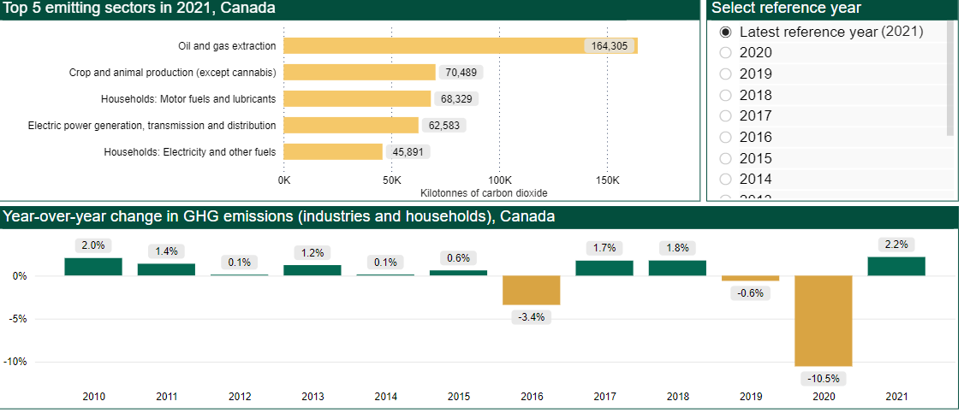
Environmental–economic accounting: Physical flow account for greenhouse gas omissions
The energy use and greenhouse gas (GHG) emissions data reflect the production and consumption activities that contribute to Canada’s gross domestic product (GDP).
From 2009 to 2021, the economy grew 2.0% per year on average, while industrial GHG emissions dropped by 0.2% per year.
Notes:
Sources of labour productivity growth in the business sector (average annual basis) (statcan.gc.ca)
https://cabe.ca/wp-content/uploads/2023/09/Wulong-Gu_Productivity-Performance-in-Canada.pdf

Slide 16
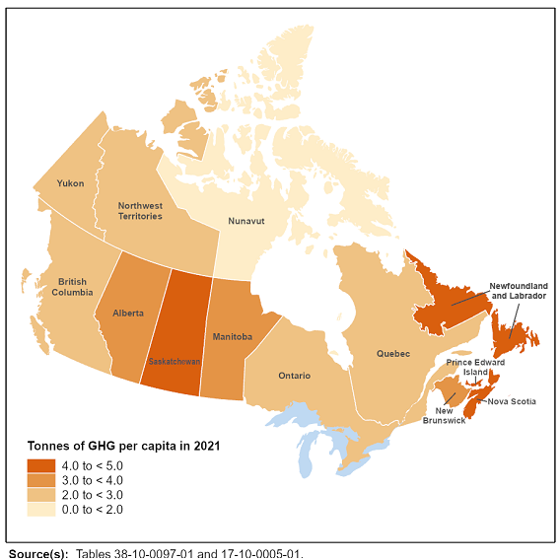
Environmental–economic accounting: Per capita GHG emissions, 2021
Households were the primary GHG emitters in 2021 across many provinces and territories.
Household use of motor fuels and lubricants was the main source of emissions for Newfoundland and Labrador (18.7%), Prince Edward Island (26.4%), Quebec (17.7%) and Ontario (15.2%).
Electric power generation, transmission and distribution was the most significant source of GHG emissions in Nova Scotia (42.7%), New Brunswick (24.5%) and Saskatchewan (25.2%) in 2021.
The oil and gas extraction industry was the largest GHG-emitting industry in Alberta in 2021, accounting for just over half (51.2%) of the province's total emissions.

Slide 17
Beyond GDP: More emphasis on economic well-being and sustainability
What does going beyond GDP mean? And why is it important?
Going beyond GDP “explicitly requires breaking down barriers to better understand trade-offs through integrating across environmental, economic and social perspectives”—and understanding these trade-offs requires developing coherent, integrated data that can adequately bridge the gap between the social, economic and environmental spheres.
The challenge: Developing integrated, coherent and comparable data (to facilitate time series analysis and cross-country comparisons).

Slide 18
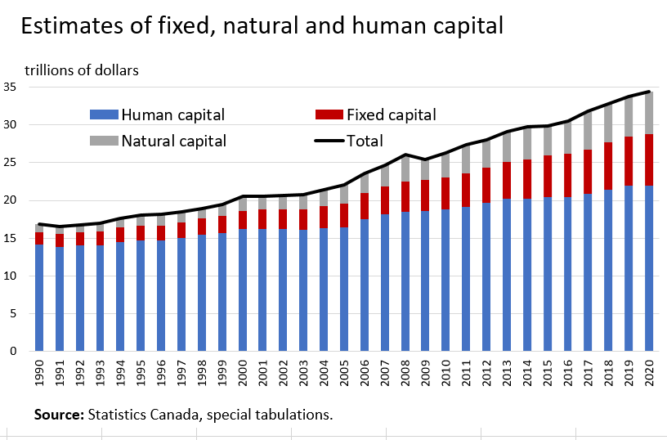
Beyond GDP: Developing extended measures of capital to estimate comprehensive wealth
Between 2008 and 2010, Statistics Canada participated in a UNECE working group that was tasked with developing a measurement framework for human capital.
Human development expenditures are treated as investment—investment that is accumulated into human capital stocks and added to national wealth.
The value of human capital in Canada in 2020 was estimated to be $22 trillion, while the combined value of fixed and natural capital was $12.4 trillion.

Slide 19
Beyond GDP: Developing extended measures of capital to estimate comprehensive wealth
Human capital is not included in estimates of national wealth as part of SNA 2025
Challenges persist around the measurement of social capital
The rich dimensionality of Statistics Canada’s Quality of Life Framework underscores the challenges around developing robust measures of social capital.
This would require broad consensus among statistical agencies about what social statistics should be collected, and how they could be integrated into the stock–flow framework that characterizes the SNA.

Slide 20
Statistics Canada: Leading international efforts
In 2022, the United Nations Statistical Commission requested a review of social and demographic statistics, creating a Friends of the Chair Group to review existing work and make formal recommendations.
Statistics Canada leads a key part of this effort, developing advice on a conceptual framework for social statistics—one that is interoperable within social statistics and better integrated with the economic and environmental statistical pillars.
The agency also chairs the U.N. Network of Economic Statisticians. One of its priorities is moving beyond GDP to better support decision-makers in facing the complexity of trade-offs across economic, social and environmental domains.

Slide 21
Calls for greater integration between economic, environmental and social pillars

Slide 22
The NES journey beyond GDP
2022 sprint series – What is “Beyond GDP”?
The research prospectus
Expert Group for Wellbeing Measurement
2023 sprint series – How are we delivering “Beyond GDP”?
2024 UNSC report

Slide 23
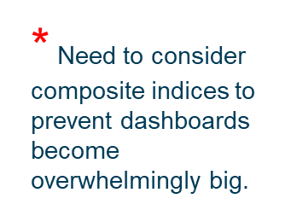
 | Subjective measures of wellbeing | Objective measures of key drivers of wellbeing (Beyond Income) | Objective measures of the degree of Inclusion and Inequality (Beyond Average) | Objective measures of the degree of sustainability and resilience (Beyond Today)
The ‘Here and Now’ lens | Subjective measures of individual wellbeing Business sentiment | Flow measures of key drivers from: Social, Environmental Economic statistics | Social, economic and environmental flow distributional measures | Social flow measures Economic flow measures Environmental flow measures
The ‘Elsewhere’ lens | Cross-border subjective measures Regional subjective measures | Social, economic and environmental flow cross-border objective measures | Social, economic and environmental cross-border flow distributional measures | Social, economic and environmental cross-border flow measures
The ‘In the Future’ lens | Social capital stock measures | Social, economic and environmental stock objective measures | Social, economic and environmental stock distributional measures | Social, economic and environmental stock distributional measures
Potential key data-frames | Social statistics | Social & Demographic Statistics SNA SEEA | Social and Demographic Statistics SNA SEEA | Social and Demographic Statistics SNA SEEA

Slide 24
Friends of the Chair of Social and Demographic Statistics
Strategic recommendations for strengthened social and demographic statistics
55th session
UNSC
Mar ’23- Feb ‘24
Mar ’24- Feb ‘25
Mar ’25- Feb ‘26
57th session
UNSC
Year 1
Year 2
Year 3
Main challenges
Lack of an overarching conceptual framework
Difficulty of modeling social phenomena
Growing demand for data disaggregation and timeliness
Declining response rates and rising survey costs
Tight fiscal environments
Decentralized statistical responsibilities
Low public acceptability for administrative data linkages

Slide 25
Building blocks for a conceptual framework for social and demographic statistics
OUTCOMES
PEOPLE
TIME
Qualitative or compound measures to be assessed both objectively and subjectively.
Objective: education, health, time use (such as unpaid work, work-life balance and leisure), employment, income, wealth and housing, among others
Subjective: well-being, including physical and mental health, learning, sense of purpose, meaningful work
The fabric, object, and unit of measurement for social and demographic statistics.
Population stock population flows
Characteristics of individuals (data disaggregation
and other intersectional considerations)
RELATIONSHIPS
PLACES
Time as an aid in understanding and anticipating changes in population, distribution
outcomes and relationships.
Time series to monitor progress
Life perspectives
Age-specific lenses
Cohort-based analyses
Interactions between individuals which collectively build up a society.
Family structures
Social connections,
confidence in institutions
Geography as an element for analyzing social and demographic statistics
and as a link across themes and domains.
Geographic disaggregation
Geospatial analysis
Small-area estimation

Slide 26
Statistics Canada – Your National Statistical Agency
%
Delivering insight through data for a better Canada

